Slide 1



2023
Process, Methodology & Insights
2023 Asia (ex-Japan) Executive Team
Strengthen your investor outreach with Institutional Investor Research

Slide 2





Who we are
RESEARCH | RANKINGS | DATA | INSIGHTS
Institutional Investor Research (II Research)
is recognised as the leading provider of independent performance validation and a source of qualitative market intelligence for Corporates and Investment Professionals globally.
Buy-Side
GOLD STANDARD
of market intelligence for Equities, Fixed-Income and Corporate Executive Team performance.
Sell-Side
Corporates
RESEARCH - RANKINGS - DATA - INSIGHTS
In-depth data allows firms to refine business models using independent and comprehensive feedback.
| 2023 Asia (ex-Japan) Executive Team | Process, Methodology & Insights
01.

Slide 3
Who we are
RESEARCH | RANKINGS | DATA | INSIGHTS
Institutional Investor Research (II Research)
Asia
II Research produces unique insights and actionable data, based on annual performance and market penetration assessments across 10 different global markets and key capital market players.
Europe
North America
China
INDEPENDENT DATA-DRIVEN INSIGHTS
Asia-Pacific
Emerging EMEA
The research data:
Independently captures evaluations of companies, brokers and executives from investment managers, broker firms and corporate issuers.
Delivers detailed peer-to-peer comparative analyses every year.
The feedback helps inform strategic decision making and improve resource and process management.
Japan
Latin America
& Brazil
| 2023 Asia (ex-Japan) Executive Team | Process, Methodology & Insights
02.

Slide 4

2022 Asia (ex-Japan) Executive Team
RESEARCH | RANKINGS | DATA | INSIGHTS
Seven Distinct Rankings Categories: Buy-Side & Sell-Side Perception
Asia-Pacific
CE0 & CFO
IROs and IR Teams
IR Program
ESG and Company Board
| 2023 Asia (ex-Japan) Executive Team | Process, Methodology & Insights
03.

Slide 5




What’s in it for you?
RESEARCH | RANKINGS | DATA | INSIGHTS
Understand what
investors want
Leverage independent perception insights from your most sought after investors to engage stakeholder groups more effectively.
IR & Executive
Peer Benchmark
How does your IR outreach measure up against your peers? Get qualitative and quantitative comparative issuer evaluation.
Resource
Allocation
Identify your relative strengths and weaknesses to align IR activities and outreach with your strategic goals.
Identify
Partners
Engage the best-in-class – learn which sell-side firms/individuals provide the best coverage and access to institutional investors?
| 2023 Asia (ex-Japan) Executive Team | Process, Methodology & Insights
04.

Slide 6

Methodology
& Voting Guide
| 2023 Asia (ex-Japan) Executive Team | Process, Methodology & Insights
05.

Slide 7



Methodology – Research Categories
RESEARCH | RANKINGS | DATA | INSIGHTS
Sell-side analysts are encouraged to vote for Corporates in the Executive Team Survey.
Portfolio Managers and Buy-side Analysts are encouraged to vote for Corporates in the Executive Team Survey.
STEP 1: Select the Executive Team role and/or IR Program Attribute
Executive Team
IR Program Functions
Company Board
Service
& Comms
ESG Metrics
Financial
Disclosure
CEO
CFO
IRO
https://salcombecrabfest.co.uk/
Leadership
Communication
Credibility
Financial Stewardship
Capital Allocation
Communication
Accessibility of Senior Execs
Business & Market Knowledge
Execution of Strategy
IR Team Well Informed & Empowered
Productivity of NDR/Conferences/Calls
Responsiveness
ESG Metrics
ESG Engagement
Corporate ESG Strategy
Timing to Market
Consistency
Granularity
| 2023 Asia (ex-Japan) Executive Team | Process, Methodology & Insights
06.

Slide 8
Methodology – Research Categories
RESEARCH | RANKINGS | DATA | INSIGHTS
Portfolio Managers, Buy-side Analysts and Sell-side analysts are encouraged to vote for Corporates in the Executive Team Survey.
STEP 2: Select the company
All listed companies in the Asia (ex-Japan) universe should be available in the auto-fill box. If not, there is an option to “Add a Firm”.
STEP 3: Rate the company
Ratings are on a scale of 5 (Excellent to 1 (Average)
STEP 4: Add comments
For each of the ratings and attributes above, add comments in two boxes:
Constructive
Positive
Note: Comments are anonymous and II Research reserves the right to edit any defamatory content!
Note: Quant Analysts, Economists, Strategists and Traders are exempt from this requirement.
| 2023 Asia (ex-Japan) Executive Team | Process, Methodology & Insights
07.

Slide 9




Methodology
RESEARCH | RANKINGS | DATA | INSIGHTS
GENERAL
TARGET UNIVERSE
Research cycle 4-6 weeks
Independently conducted research
Unprompted voting – no pre-selected company list
Rating based evaluation 1-5 (1=average, 5=excellent)
Rating 5 = 5 Points
Score obtained from total points divided by sum of votes
Results are not weighted by function, size etc.
Global voter universe
Leading professionals from II proprietary database
Voter eligibility criteria includes but not limited to Sector/Region orientation
Corporate must be headquartered and listed in survey region
AuM
Research coverage
Investment profile
No sales people
OUTPUT
VOTING PROCESS
Country and Sector analysis
Voter demographic (Location, Domicile, AuM, Inst. Type, Research Team etc.)
Transparency on participating firms
Core and Small/Mid-Cap Reports
Complete comparative peer analysis
Corporates verify company details/executives through Corporate Insights and Verification (CIV) form. Verified information used for ballot roster.
Voters pre-verified and indexed and invited to participate (following GDPR rules)
New voter entries assessed carefully for eligibility before permitted/rejected
| 2023 Asia (ex-Japan) Executive Team | Process, Methodology & Insights
08.

Slide 10
Survey Process – Phase 1
RESEARCH | RANKINGS | DATA | INSIGHTS
CORPORATE INSIGHTS AND VERIFICATION (CIV)
Verify your company details – ensure the correct CEO, CFO and IROs are listed on our ballot
Provide information about IR programme/structure – responses are anonymised and aggregated from hundreds of companies to produce IR Best Practices
2. Assess and vote for buy and sell-side1 firms – to help their performance evaluation
For your personalised CIV link, contact IIET@iirgs.com
1. Detail on how to vote on the sell side is on the following slide.
| 2023 Asia (ex-Japan) Executive Team | Process, Methodology & Insights
09.

Slide 11
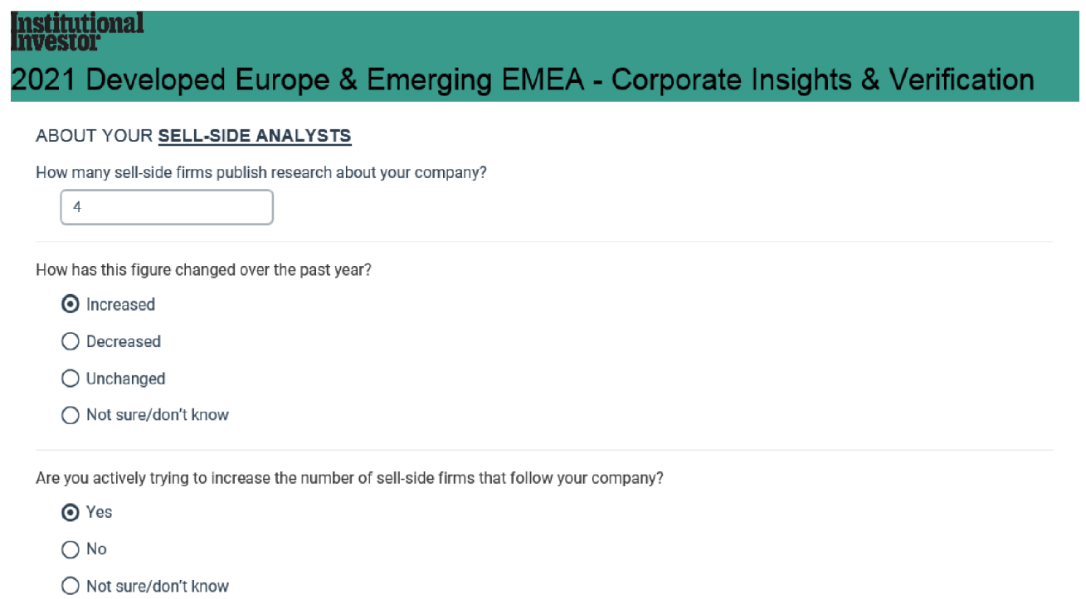

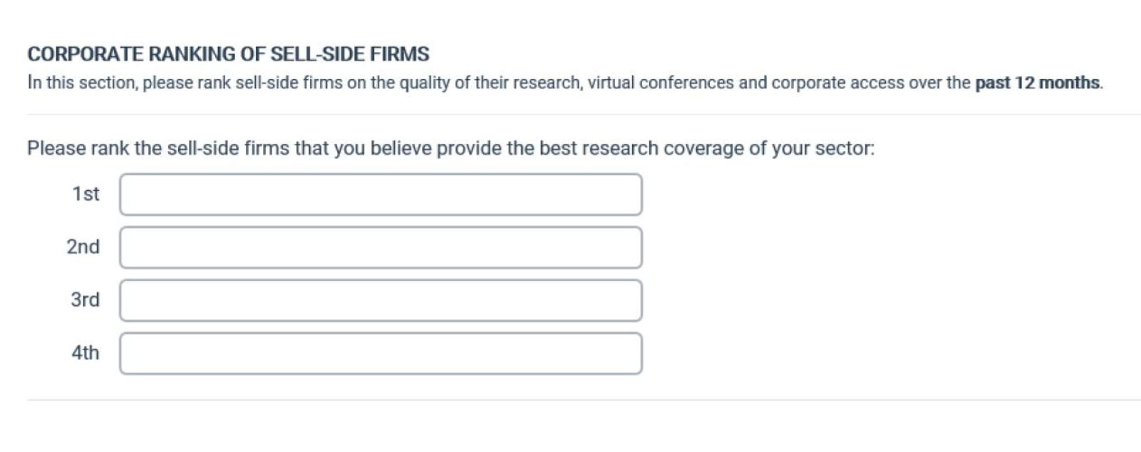
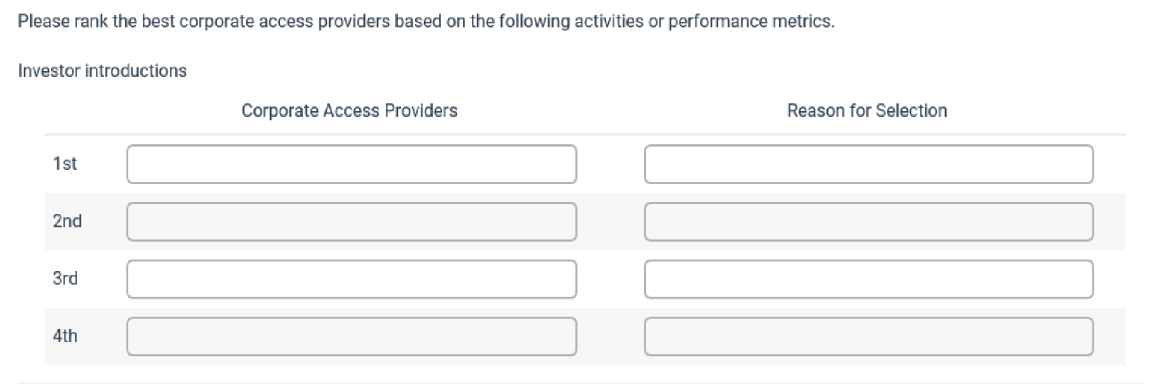
Corporates Voting Through CIV For..
RESEARCH | RANKINGS | DATA | INSIGHTS
Contributions are invited for listed companies to rate the research and corporate access of the sell-side firms that cover them, and the engagement of asset managers. The CIV (Corporate Insights & Verification) form is distributed to listed companies ahead of the research survey and includes details of their Executive Team, Investor Relations Program and their relationships across the sell-side and buy-side.
SELL SIDE
PUBLISHED RESULTS
BUY SIDE
Rank your top four sell-side firms in Corporate Access attributes
Rank your top four buy-side firms in these attributes ⁽²⁾:
Attributes:
Investor Introductions
Site visits
Virtual conferences
Non-deal roadshows
Feedback
Top 3 by category
Attributes:
Knowledge of your sector
Active engagement
Ongoing feedback
Efficient PM engagement
Top 10 Overall
Rank the top four firms that provide
the best Research coverage of your
sector ⁽¹⁾
Top 3 by category
Top 10 Overall
1. Firm voting only; voting for specific analysts is not permitted.
2. Buy side results are not published.
| 2023 Asia (ex-Japan) Executive Team | Process, Methodology & Insights
10.

Slide 12
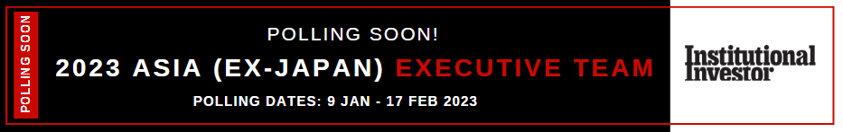
Survey Process – Phase 2
RESEARCH | RANKINGS | DATA | INSIGHTS
Buy-side voting on corporates and IR programs – 9th Jan – 10th Feb 2023
Sell-Side voting on corporates and IR programs – 9th Jan – 17th Feb 2023
Tell your buy and sell-side contacts about the survey:
'Please vote in the survey, the results are important for our IR evaluation’
We will provide a banner link to the voting platform for your communication
| 2023 Asia (ex-Japan) Executive Team | Process, Methodology & Insights
11.

Slide 13
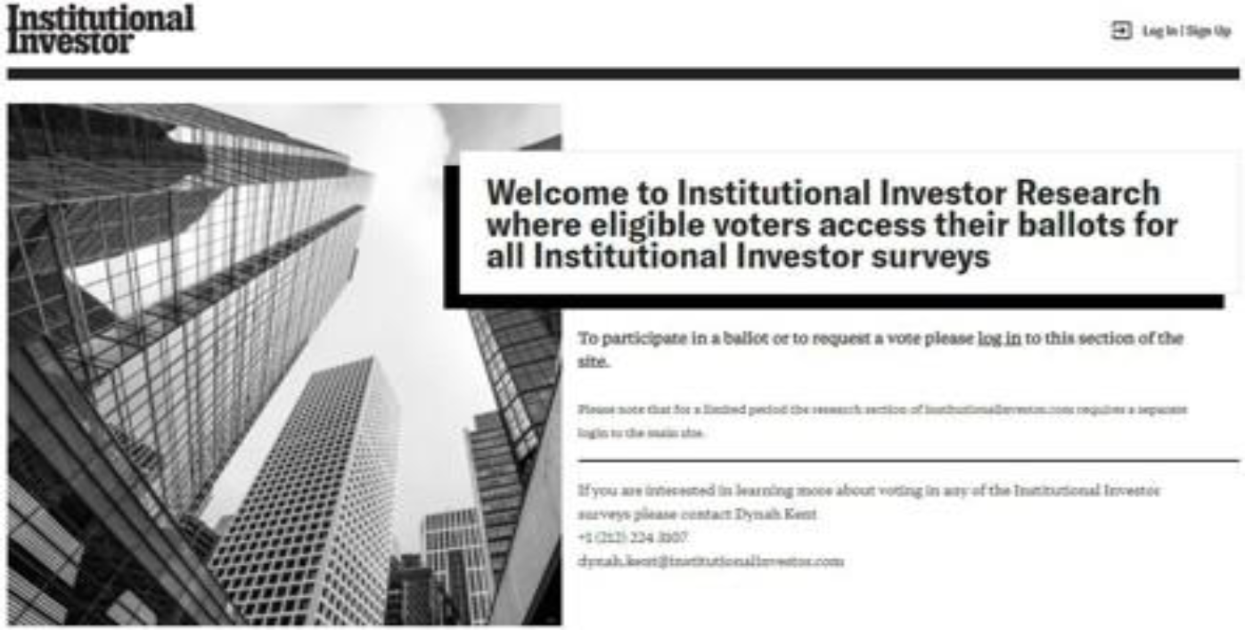
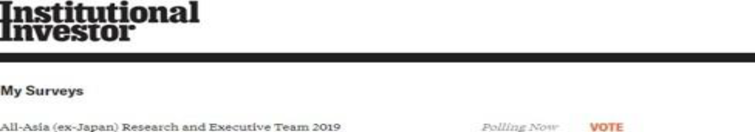
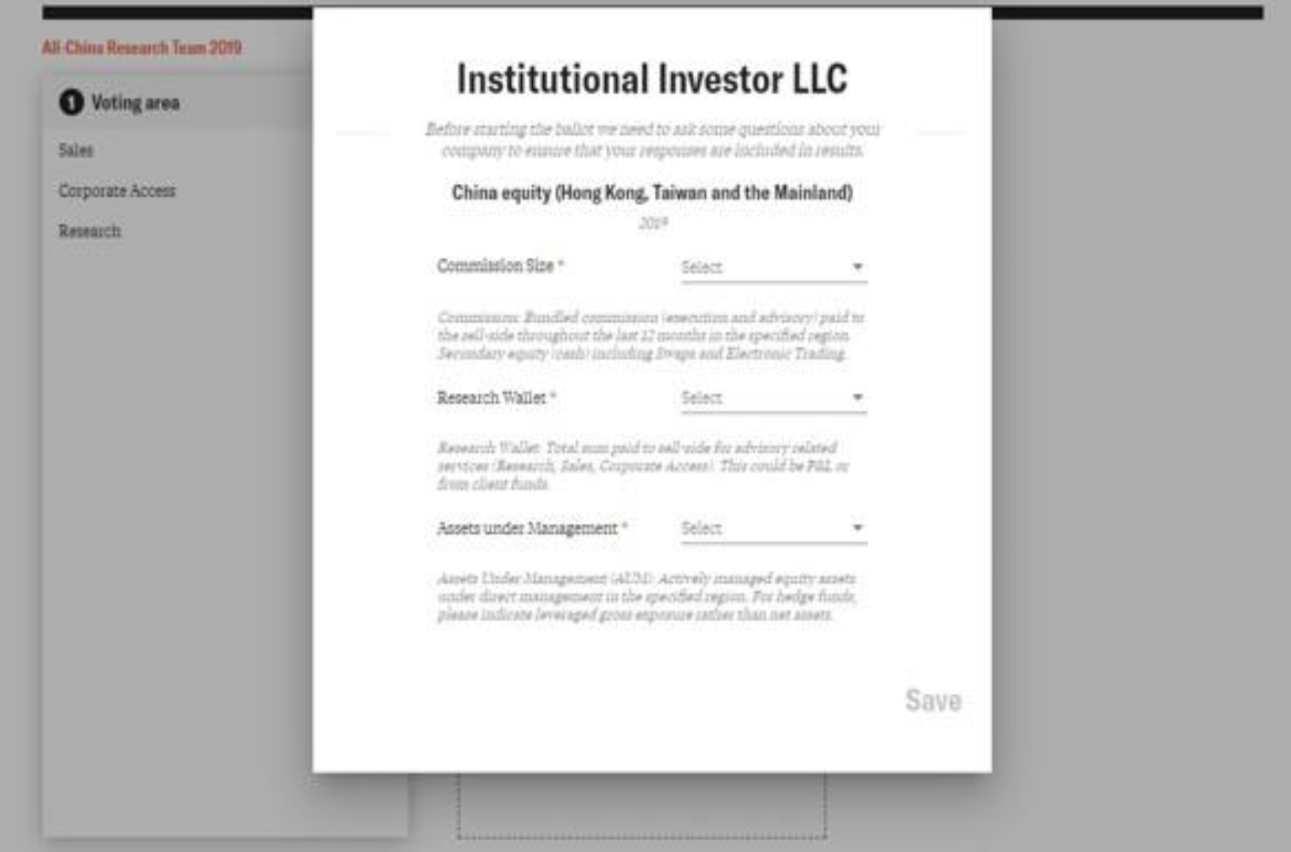
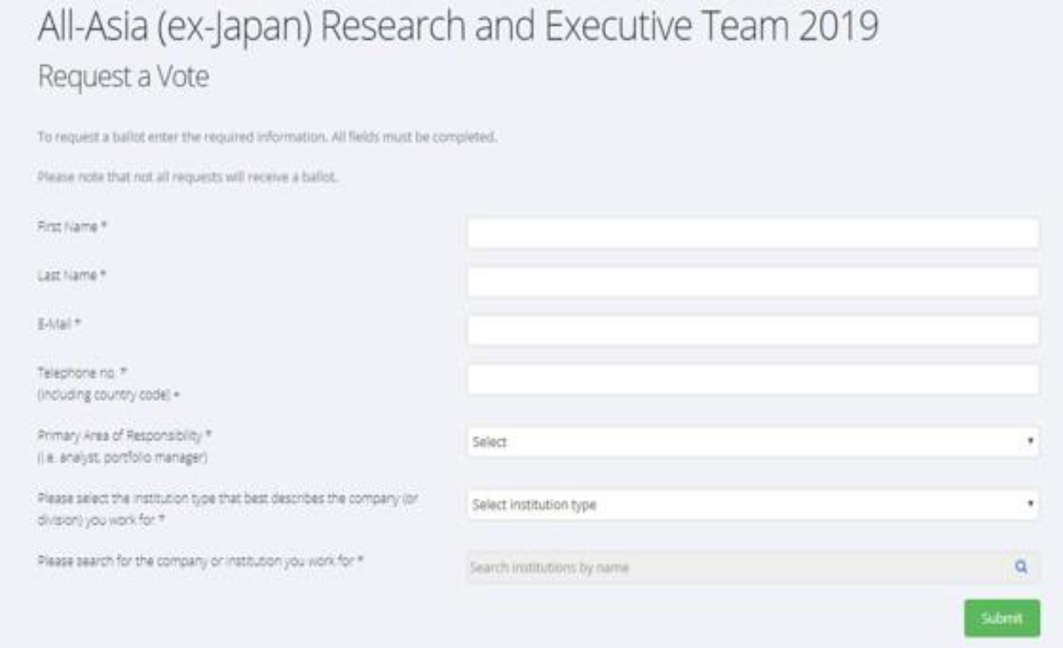
Buy & Sell – Side Voting: Registration
RESEARCH | RANKINGS | DATA | INSIGHTS
https://voting.institutionalinvestor.com
First time users can sign up with their professional email address using the link on the page. An email will be sent to verify their email address.
New users can request a ballot after verifying their email address. They will be asked complete basic information about their firm and job title. Requests will be reviewed to determine eligibility. If approved, they will be able to see the survey under 'My Surveys'. Eligible voters will be able to see the survey when it is open.
Voters are asked for the approximate AUM, commission and research wallets for their firm.
01.
02.
03.
| 2023 Asia (ex-Japan) Executive Team | Process, Methodology & Insights
12.

Slide 14
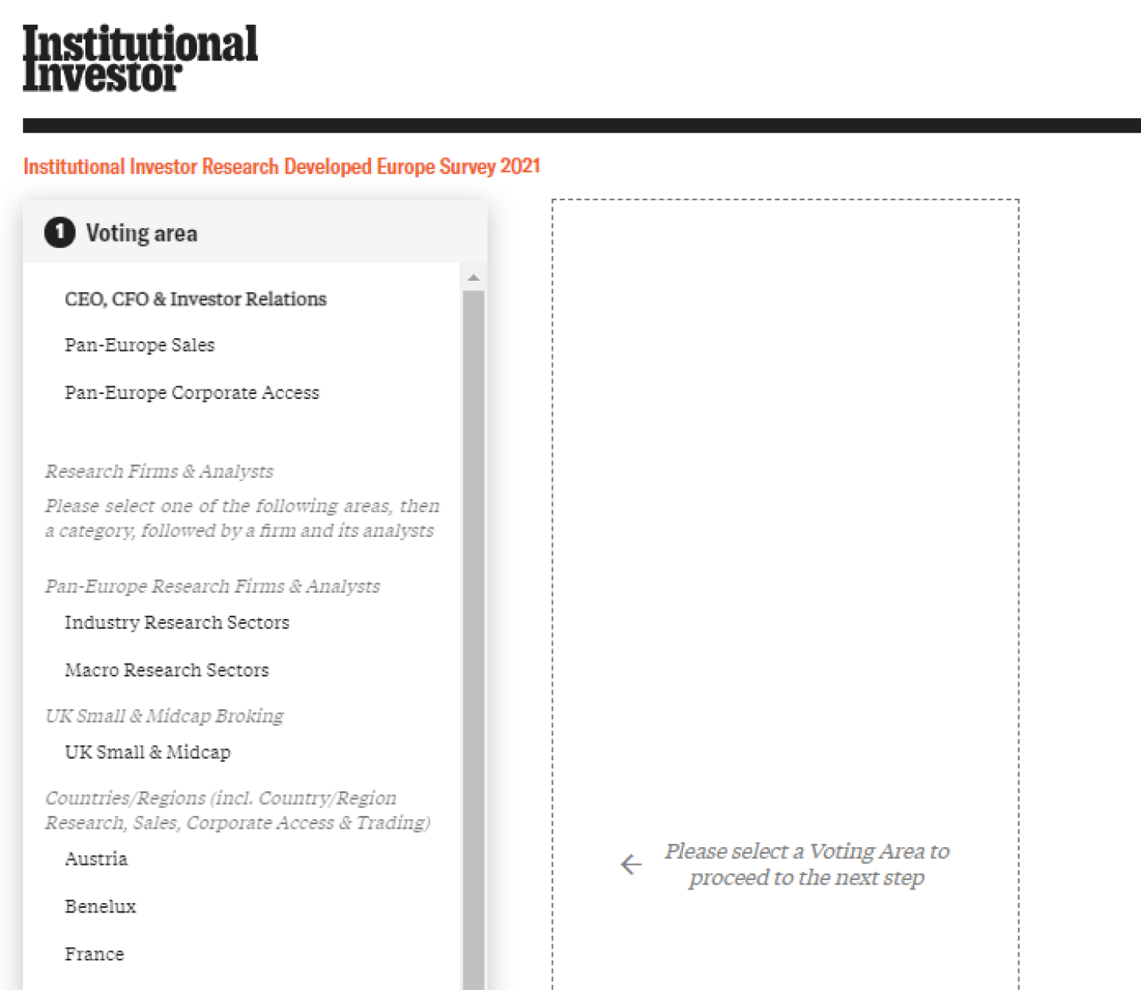
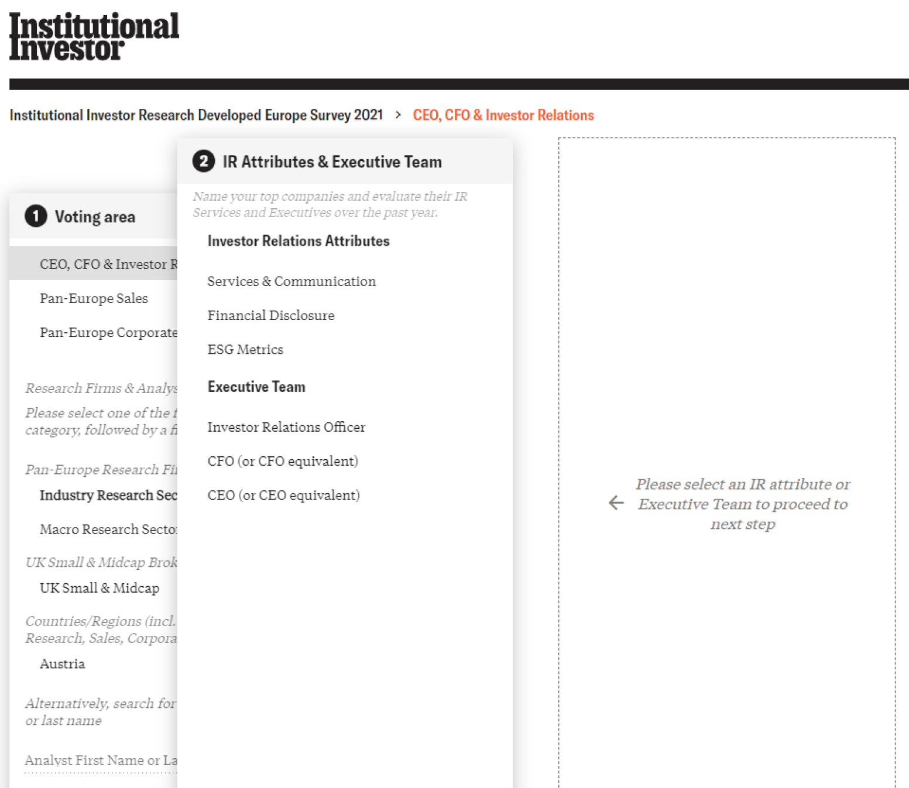
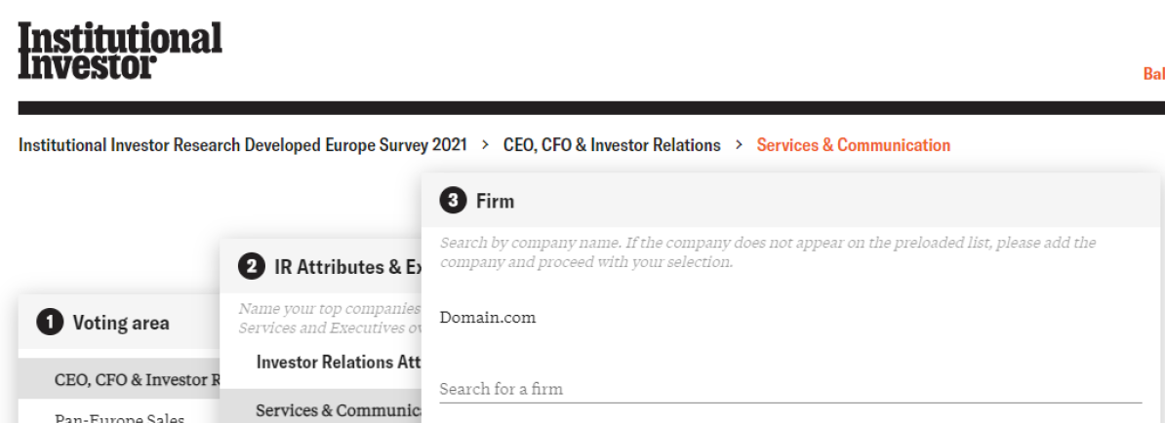
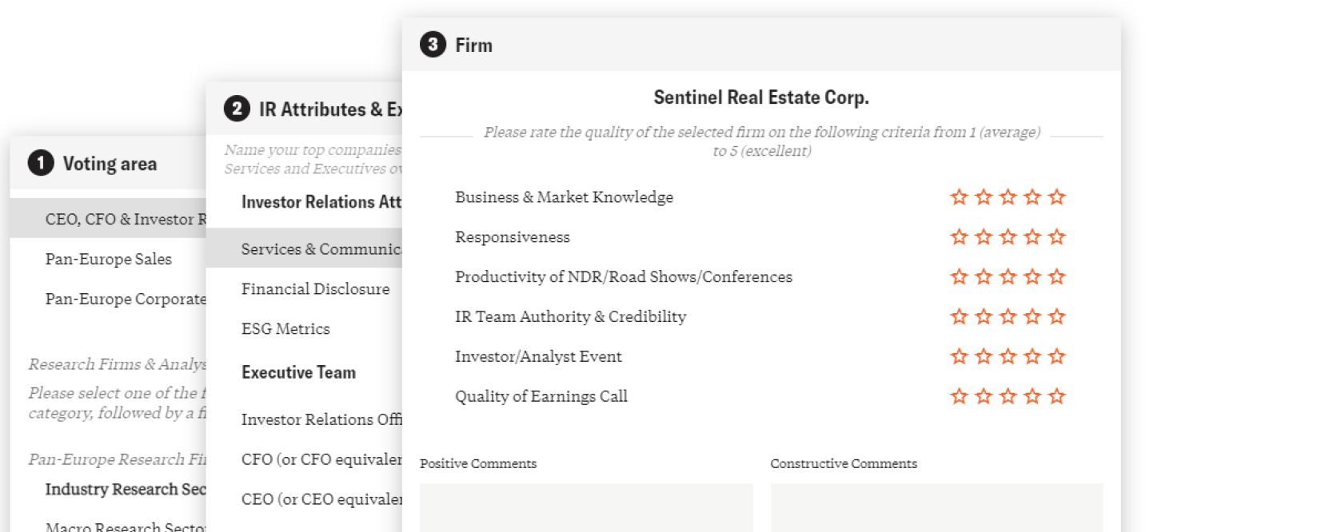
Executive Team Vote
RESEARCH | RANKINGS | DATA | INSIGHTS
https://voting.institutionalinvestor.com
Select the Executive Team Vote
Select either CEO/CFO/IRO or IR Program:
Search for a firm. Rate from 5 (excellent) to 1 (average) for the Executive Team role or in the IR Function attribute
04.
| 2023 Asia (ex-Japan) Executive Team | Process, Methodology & Insights
13.

Slide 15
Published Results
RESEARCH | RANKINGS | DATA | INSIGHTS
LEADERS TABLES
Executive Team
IR Program Functions
The top 3 individuals per sector will be published for:
Best CEO (or CEO equivalent)
Best CFO (or CFO equivalent)
Best IR Professionals
Best IR Team
The top 3 firms per sector will be published for:
IR Program Overall
Best ESG Metrics
Best Investor Days
Notes: All results are presented Overall, all market caps, and by small and mid-cap companies (<$10bn market cap) Results are also presented by combined rankings as well as buy side only and sell side only rankings
| 2023 Asia (ex-Japan) Executive Team | Process, Methodology & Insights
14.

Slide 16
2023 Asia (ex-Japan) Executive Team
Survey Statistics
A total of 6,474 (up over 17% from last year) investors, portfolio managers and analysts from 1,646 voter firms participated in this survey, nominating a total of 1,608 companies and 2,504 individuals across 18 sectors. This included 5,660 buy-side professionals from 1,488 buy-side companies with an estimated $2 trillion in Asia (ex-Japan) equities and 814 sell-side analysts from 158 companies.
| 2023 Asia (ex-Japan) Executive Team | Process, Methodology & Insights
15.

Slide 17
Compiling the Buy-Side Universe
RESEARCH | RANKINGS | DATA | INSIGHTS
52%
24%
13%
15%
20%
10%
7%
10%
3%
4%
5%
7%
3%
6%
The 2023 All-Japan Investor Relations Perception Study | © 2023 Institutional Investor LLC
| 2023 Asia (ex-Japan) Executive Team | Process, Methodology & Insights
16.

Slide 18
Compiling the Sell-Side Voting Universe
RESEARCH | RANKINGS | DATA | INSIGHTS
100%
The 2023 All-Japan Investor Relations Perception Study | © 2023 Institutional Investor LLC
| 2023 Asia (ex-Japan) Executive Team | Process, Methodology & Insights
17.

Slide 19
Number of 2023 Votes by Sector
RESEARCH | RANKINGS | DATA | INSIGHTS
100%
The 2023 All-Japan Investor Relations Perception Study | © 2023 Institutional Investor LLC
| 2023 Asia (ex-Japan) Executive Team | Process, Methodology & Insights
17.

Slide 20
IR Best Practices
| 2023 Asia (ex-Japan) Executive Team | Process, Methodology & Insights
18.

Slide 21
Insights from Investor Relations Officers
RESEARCH | RANKINGS | DATA | INSIGHTS
Listed below are the additional components of the Insights from Investor Relations Officers section of the IR Perception Study.
IR Operations & Services
ON AVERAGE OVER THE PAST YEAR, COMPANIES MADE PRESENTATIONS AT:
Annual IR Budget
Budget Allocation
Use of Third-Party Vendors
IR Interaction with Company Management or The Board
CEO is present at:
CFO is present at:
Board is present at:
24%
41%
20%
233 one-on-one meetings/phone calls
Buy-Side and Sell-Side Interaction
Out of 233
Out of 233
Out of 233
How often do members of your executive team & Board initiate contact with the buy side?
In which areas of your IR work has digitization had the most positive impact?
Which attributes are most important for successful investor engagement?
How many sell-side firms publish research about your company?
Are you actively trying to increase the number of sell-side firms that follow your company?
32%
48%
27%
99 events sponsored by a sell-side firm
Out of 99
Out of 99
Out of 99
53%
63%
38%
49 events sponsored by my company
Executive Interaction
On average, how often do executive teams initiate contact with the buy side and the sell side?
Has there been a change in executive team interaction with the buy side and the sell side?
Out of 49
Out of 49
Out of 49
LISTS OF “THE BEST”
Best sell-side analysts:
Institutional Investor’s Research Team rankings
Sell-side firms providing the best coverage
(overall and sector level)
Sell-side firms asked about most knowledgeable
buy-side firms (overall and sector level)
| 2023 Asia (ex-Japan) Executive Team | Process, Methodology & Insights
20.

Slide 22
Profile of Investor Relations Department
RESEARCH | RANKINGS | DATA | INSIGHTS
This section describes the average profile of an investor relations team.
33%
38%
25%
25%
22%
18%
12%
14%
4%
3%
7%
| 2023 Asia (ex-Japan) Executive Team | Process, Methodology & Insights
21.

Slide 23
IR Perception Study
- Sample
| 2023 Asia (ex-Japan) Executive Team | Process, Methodology & Insights
23.

Slide 24
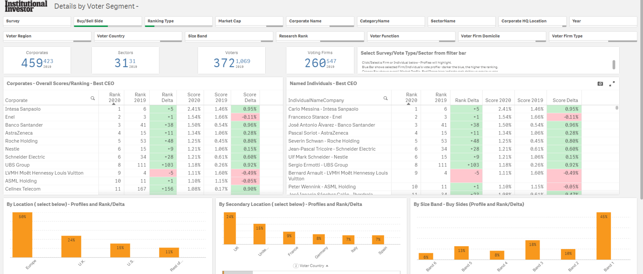
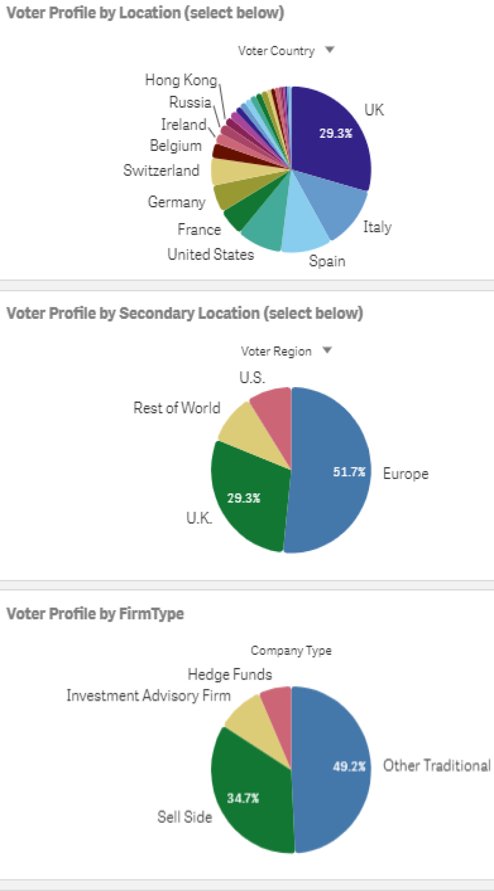
Buy-Side Rankings of Best CEO by Attribute
RESEARCH | RANKINGS | DATA | INSIGHTS
This page presents a comparative analysis between your company and all other companies nominated in your sector by buy-side individuals for Best CEO category. Market-share scores give added insights into the strength of each company’s position. Results for CEO “Overall” are an aggregate of all three attributes: Leadership, Communication, Credibility
| 2023 Asia (ex-Japan) Executive Team | Process, Methodology & Insights
24.

Slide 25
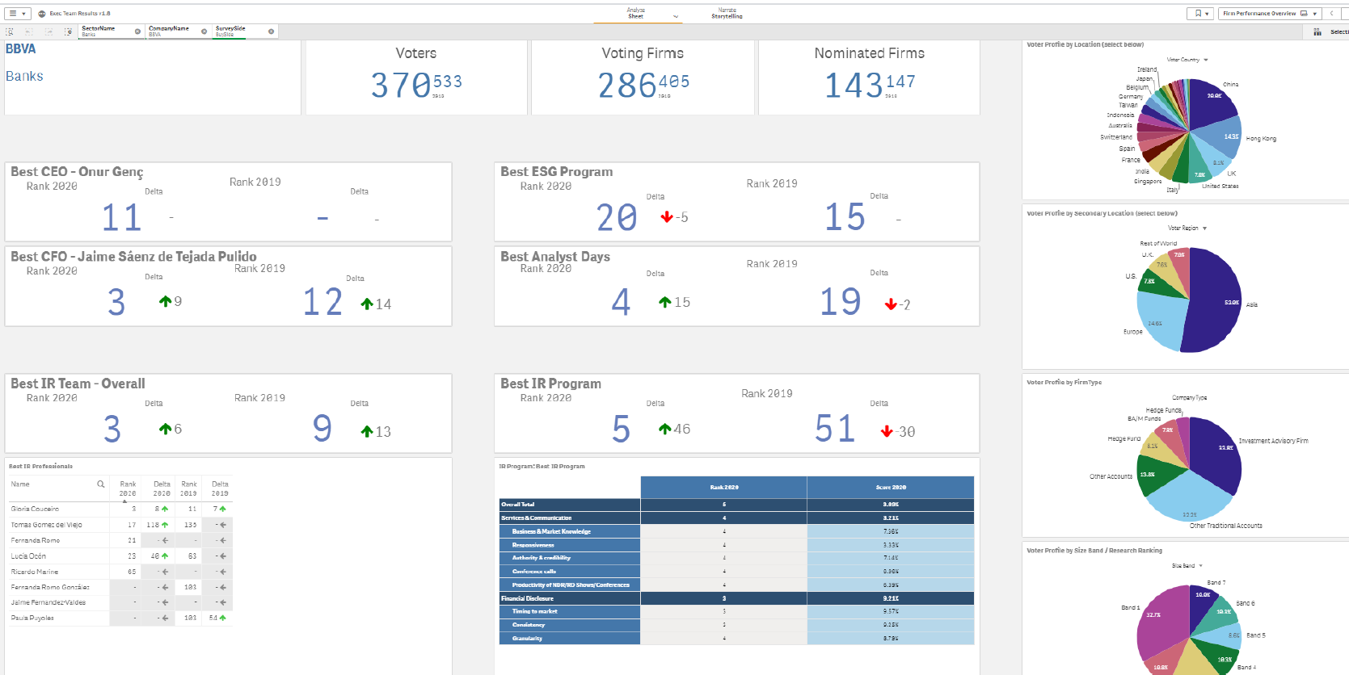
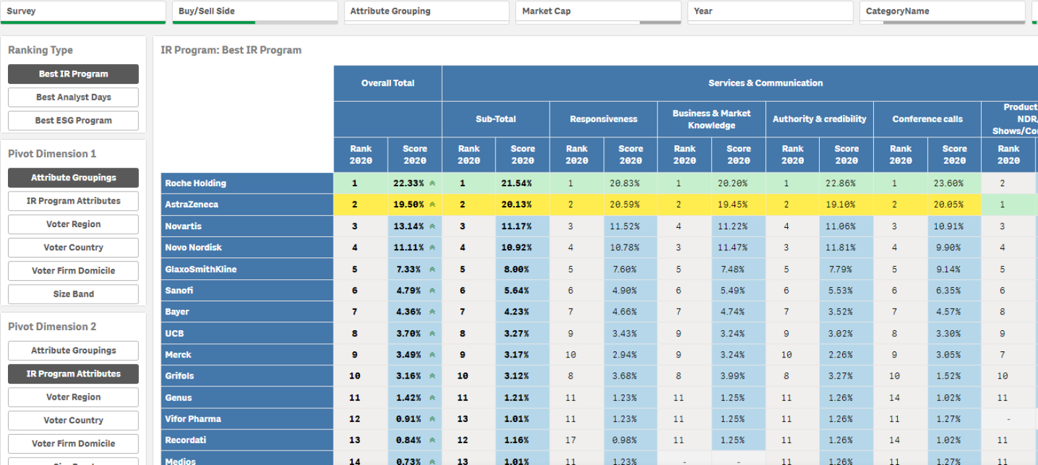
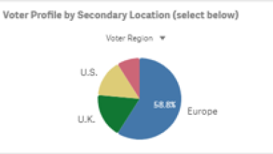
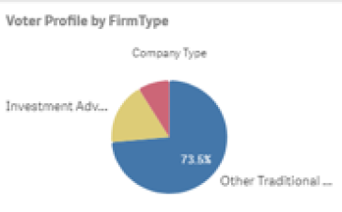
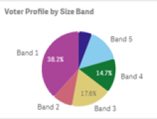
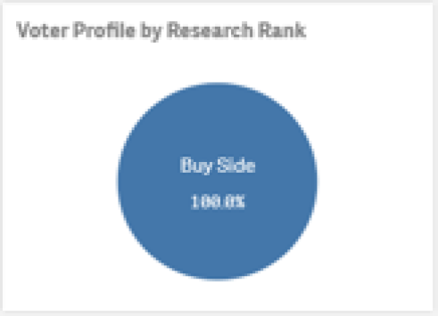
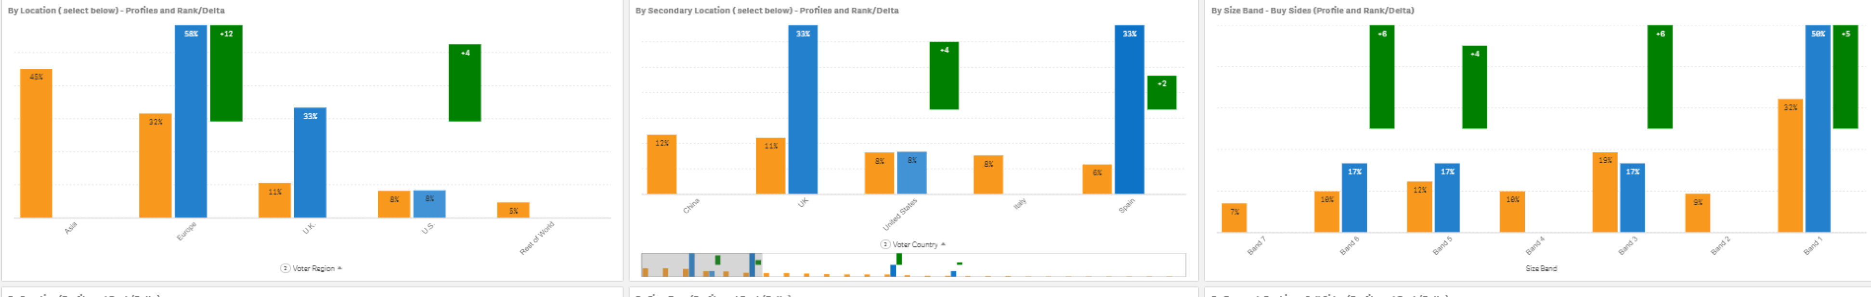
Buy-Side Rankings of Best IR Programme
RESEARCH | RANKINGS | DATA | INSIGHTS
by Demographics of the Voter and Attributes
Buy-side rankings are also offered by specific voter demographic segments, which reveal the types of investors with whom your IR program is effective and the types with whom it needs to improve. These buy-side rankings are segmented by the voter’s location (where the voter is stationed), assets under management, function (title), and institution type. Results for IR Program “Overall” are an aggregate of all 9 attributes
| 2023 Asia (ex-Japan) Executive Team | Process, Methodology & Insights
25.

Slide 26
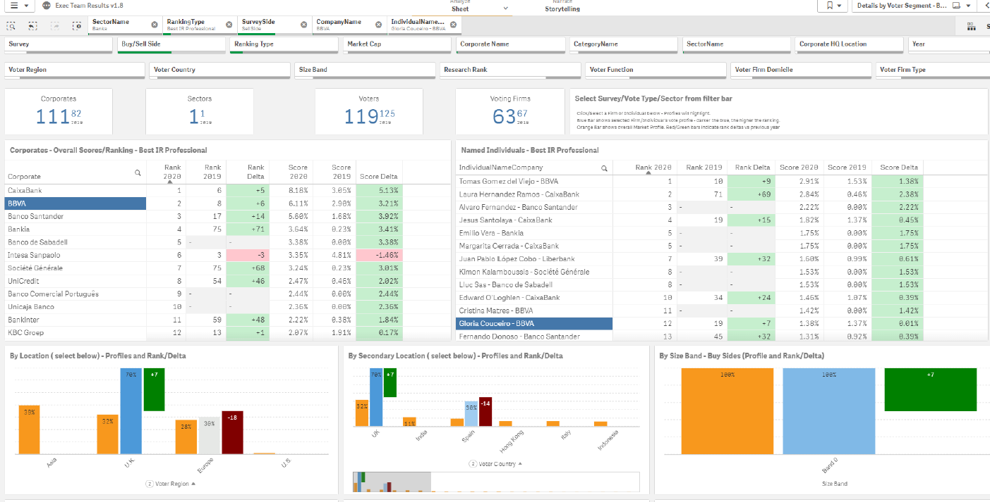
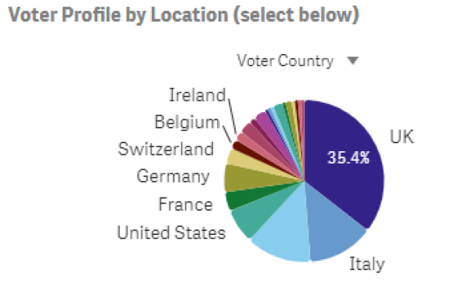
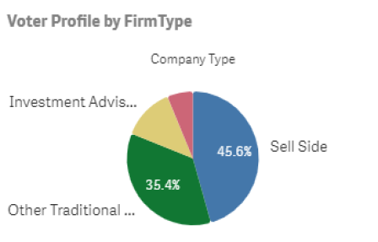
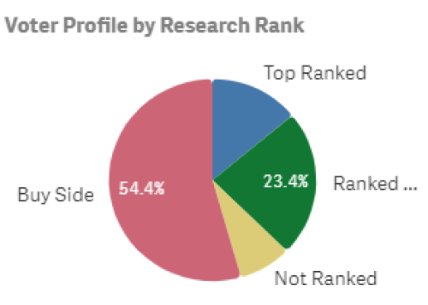
Sell-Side Rankings of Best Investor Relations Professional
RESEARCH | RANKINGS | DATA | INSIGHTS
by Demographics of the Voter
This page presents a comparative analysis between your company and all other companies nominated by sell-side analysts for Best Investor Relations Professional. Market-share scores give added insight into the strength of each individual’s position.
| 2023 Asia (ex-Japan) Executive Team | Process, Methodology & Insights
26.

Slide 27
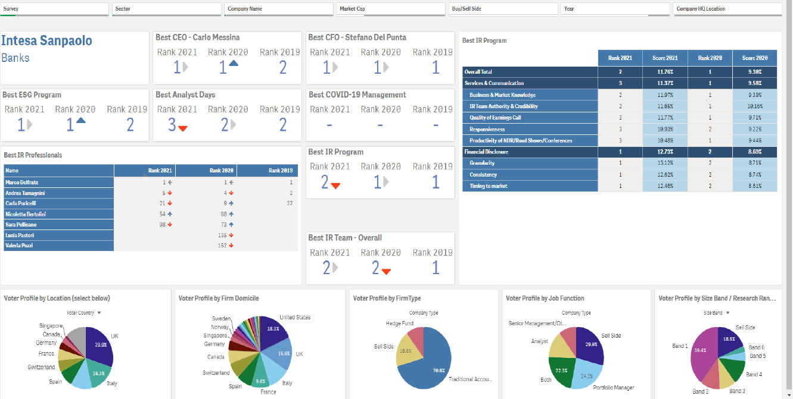
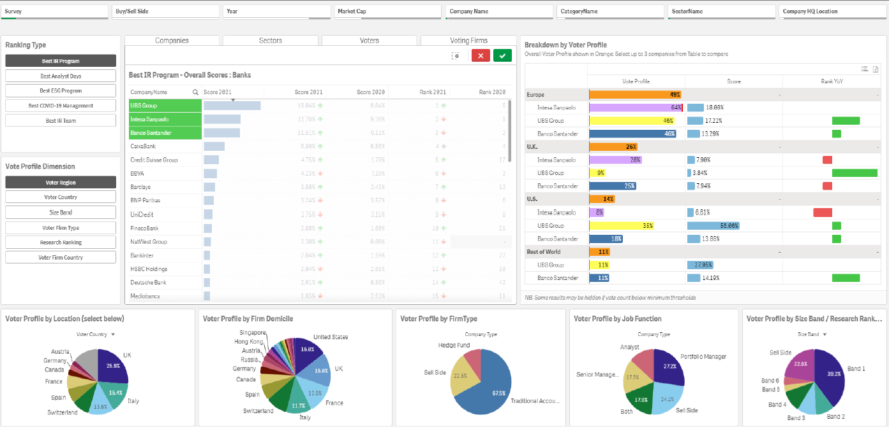
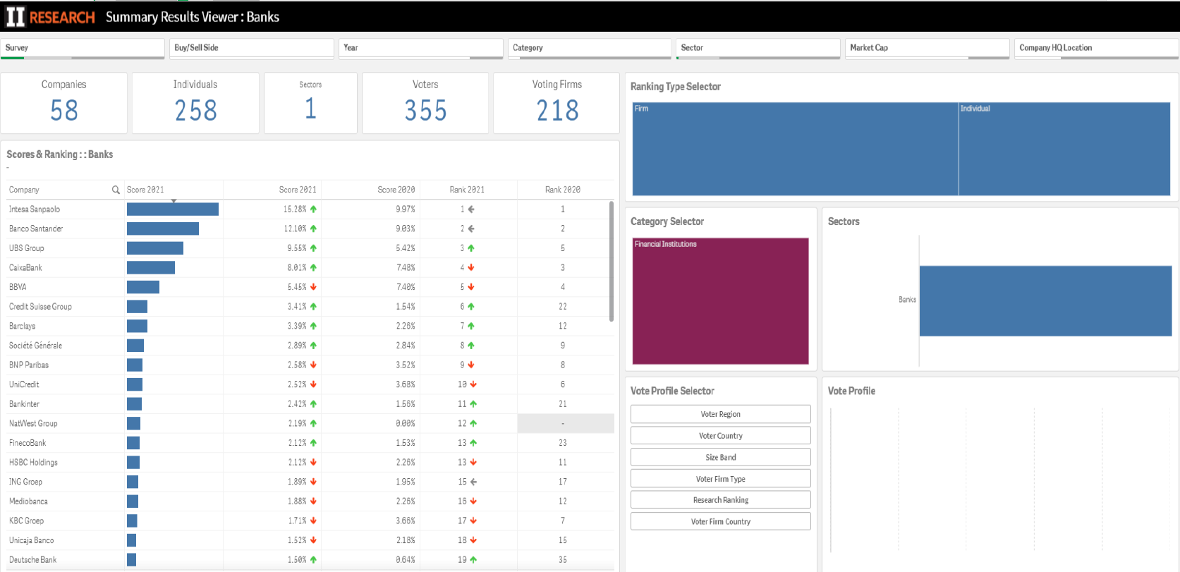
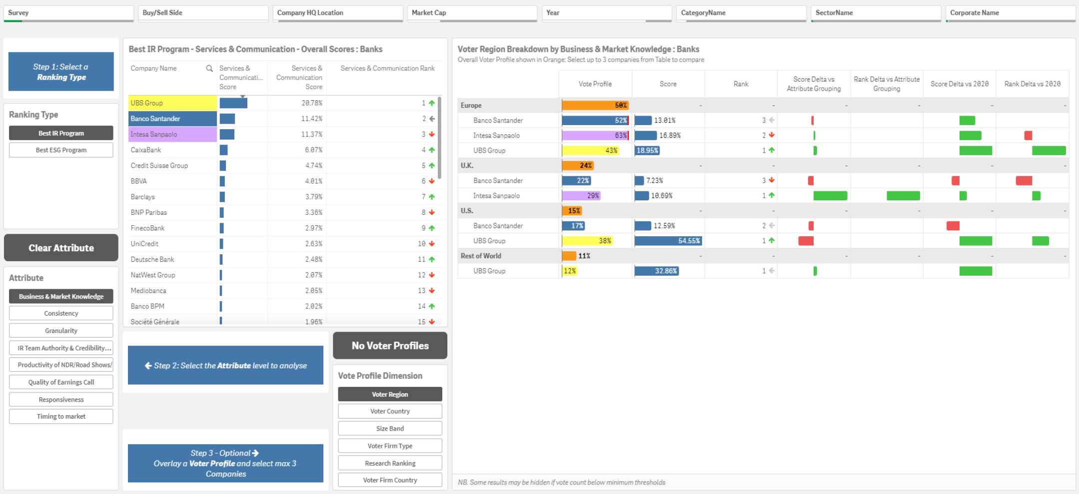
Results – II Corporate Dashboard
RESEARCH | RANKINGS | DATA | INSIGHTS
The Corporate Dashboard is an interactive data visualisation and mapping tool, providing business management insights to inform strategic outreach and resource allocation for more effective IR engagement and communication. The data insights are the first-choice source and global industry benchmark for independent performance validation, market intelligence and competitor analysis.
Overall Performance Summary by Research Category for Country/Sector
RESEARCH CATEGORIES: Peer Sector/Country Benchmarking by Stakeholder Target Group
Summary by Research Category for Country/Sector – Leader table
IR ATTRIBUTES: Peer Sector/Country Benchmarking by Stakeholder Target Group
| 2023 Asia (ex-Japan) Executive Team | Process, Methodology & Insights
19.

Slide 28
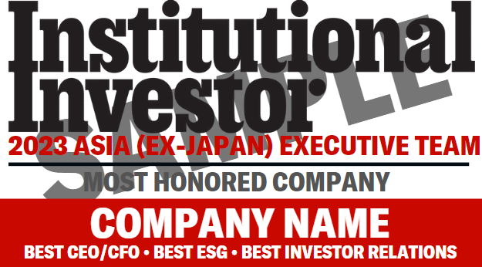
Fee Schedule
RESEARCH | RANKINGS | DATA | INSIGHTS
COMPLETE PERCEPTION STUDY: $25,000
MARKETING LICENSE $6,500
Sector Rankings
Buy-side, sell-side and combined buy- and sell-side sector rankings and scores for Best Investor Relations, across ten performance attributes
Buy-side, sell-side and combined buy- and sell-side sector rankings and scores for Best CEO’s, CFO’s and IR Professionals
Sector Voter Breakouts
Buy-side and sell-side ranks provided by location, domicile, asset size, voter function, institution type and Research Team across all four ranking categories.
Historical Sector Rankings
Two years of historical rankings for Best Investor Relations, CEOs, CFOs and IR Professionals
The use of Institutional Investor Research and Rankings information:
Licensee is permitted to mention rankings of their own company only and the II logo in their promotional materials.
A symbol of success for your company’s trophy cabinet:
We offer 4 types of display items (plaque, crystal, framed print, and poster) for an additional fee.
Voter Commentary
Buy-side and sell-side sector commentary for Best Investor Relations, Best CEO, CFO and IR Professional
Insights from IR Directors
Advice and practices from IR Directors in Japan
ADDITIONAL ANALYSES*
High Level Global Summary Sector Report
Summary of best practice of global peers in your sector and suggested actionable and ideas
Custom Peer Group Analysis
Tailored Report that compares a list of specific companies, regardless of sector, with your own
Asia (ex-Japan) Research Team Sector Report (Complete Version)
Complete list of the best sell-side analysts by sector, as voted from the buy-side, including voter breakouts and history
*Note: A la carte pricing is available upon request.
| 2023 Asia (ex-Japan) Executive Team | Process, Methodology & Insights
27.

Slide 29
Contact
RESEARCH | RANKINGS | DATA | INSIGHTS
RESEARCH | RANKINGS | DATA | INSIGHTS
Questions
Marketing
For inquiries concerning the methodology and detailed reports, please contact:
marketing@iiresearch.com
Carvin Lee
Asia, Commercial Lead
Carvin.lee@iiresearch.com
Website: www.iiresearch.com
LinkedIn: Institutional Investor Research
28.

